Slide 1
Wars of Attrition

Slide 2
Examples
Price wars fought to drive out new entrants into some market
  Holland Sweetener
  Rate cutting by KiwiAir competitors
  Browser wars
Technology battles among established players
  DRAMS in the 1970s
  LCD screen technology in the 2000s

Slide 3
More Examples
Labor negotiations
  Professional sports lockouts/cancellations
  Anthracite coal strikes in early 20th century
  Caterpillar’s labor dispute
Standards wars
  VHS v Beta
  56k modems
  BSB v Sky
Entry in emerging markets
  E-retailing wars of the 1990s

Slide 4
Recognizing Wars of Attrition
Costly for all sides to endure the “fighting” period
Reward to the “winner” of the war
No fixed endpoint to the fighting

Slide 5
Modeling Wars of Attrition
Two competing players (1 and 2)
If player 1 wins, it earns a prize equal to v₁
If player 2 wins, it receives a prize equal to v₂
It costs each player 1 per “period” to fight the war.

Slide 6
Payoffs
Suppose the war lasts for time t at which point firm 2 drops out.
Then player 1 earns
  Profit₁ = v₁ – t
And player 2 earns
  Profit₂ = - t

Slide 7
Connection to Auctions
Notice that we could think of this as a kind of auction
Each player “bids” an amount of time they want to pursue the war.
  Player 1 “bids” t₁
  Player 2 “bids” t₂
Suppose that t₂ < t₁ then player 2 drops out first
The war lasts until the time player 2 drops out t_{2.}

Slide 8
More Connection to Auctions
The winning bidder, player 1, pays player 2’s bid (like in the Vickrey auction)
But the losing player pays its own bid (unlike the Vickrey auction).

Slide 9
How Much Should I Bid?
Clearly, the amount of the bid depends on the value of the reward
Suppose values are uniformly distributed on [0,1].
Then we can use our usual formulation of bidding in auctions to analyze the game

Slide 10
Profit Maximization
Suppose that my rival is using a bidding strategy t(v).
I need to choose how much to “bid,” T, to maximize
  Profit₁ = Pr(t(v)<T) (v – E[t(v)|t(v) < T]) – Pr(t(v) > T) T
  The top of the profit “hill” is given by:
    dt/dv = v/(1- v)
  Solving this equation yields the equilibrium
    t(v) = - v – ln(1 – v)

Slide 11
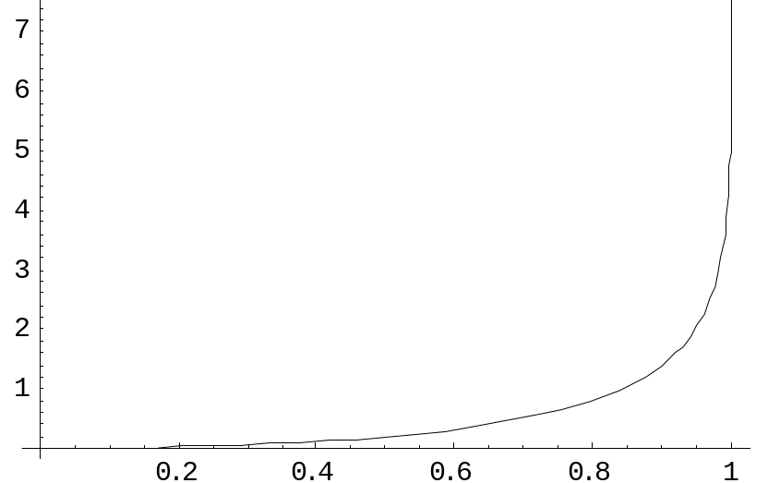
How to Bid – Graphically
Let’s look at this bidding function on a graph
Bid
Value

Slide 12
Interpretation
For values close to the highest possible value, the “bids” get arbitrarily large
  For v > .8, bids already exceed 1, the maximum value of the reward
  For v close to .9, bids are already around 6
The point is that even with completely rational bidders, wars of attrition can last a very long time

Slide 13
An Example
Suppose that v₁ = .95 and v₂ = .9
  Then the war of attrition will t = 1.4 --- both sides will end up losing money
  If v₂ also equals .95, the war of attrition will last more than t = 2 – both sides are bidding more than twice as much as what the prize is worth to either
Can this really be rational?
Are these credible threats?

Slide 14
More intuition
Consider the case where v₁ = .95 and v₂ = .9
Suppose that each side has already spent 1 in fighting the war.
  Both sides are certain to lose money
Should player 1 continue?
  Marginal benefit: There’s a small chance that player 2 will give up soon and I’ll earn the prize of .95
  Marginal cost: The tiny cost of persisting for the next small time period

Slide 15
Key insight
As long as a player believes that the chance of concession by the rival is high enough, it pays to keep fighting the war
How do you judge this probability?
  Financial capabilities
  Reputation/past actions
  Estimates of valuation of “prize” to rival
Competitor analysis is crucial in determining this probability

Slide 16
Key Pitfall
Often, firms competing in wars of attrition reason this way:
  If I maintain the fight, I’ll obtain the reward from victory at the small cost of lasting just a bit longer
  If I give up, I avoid the small cost, but lose all chance at victory
The bias in this way of reasoning is not accounting for the probability that victory in the war will come in the near future
There’s a tendency to be overly optimistic in these assessments

Slide 17
Back to Auctions
How costly are wars of attrition?
Should they be avoided entirely?
Wouldn’t the players be better dropping out immediately?
Notice that our war of attrition model fits the assumptions of the Revenue Equivalence Theorem
  That means things are just the same for the players (on average) as in a Vickrey auction
  So players do make profits (on average) in wars of attrition
  But the downside risk is much higher

Slide 18
The Value of Commitment
We saw that commitment can help players achieve advantages in other situations
What about in the war of attrition?
Suppose firm 1 implemented a policy whereby it fought in all wars of attrition until it spent t = 1.
  That is, it commits to fight up until total expenditures equal the maximum value of the prize
What should firm 2 do?

Slide 19
The Value of Commitment, Part 2
Assuming that the commitment on firm 1’s part is:
  Known to firm 2
  Irrevocable
  Credible
Then firm 2’s best reply is to immediately concede in the war of attrition
Even though firm 1 was willing to spend up to 1 on fighting, it never has to fight at all

Slide 20
Conclusions
Wars of attrition occur in many situations
Look for the warning signs of a war of attrition
If faced with a war of attrition:
  Be prepared for possible large downside
  Don’t neglect competitor analysis to determine probabilities of concession
  Update this probability frequently – it is the key to the go or no go decision
Commitment can be extremely helpful in wars of attrition
  Commitment needs to be visible, credible, and irrevocable

